Slide 1


Sleep Health & Lifestyle
Author: Thinh Le
Date: 12/12/2024
Class: Data exploration – Fall 2024
Instructors:
Dr. Clif Baldwin
Prof. Melissa Laurino

Slide 2

Introduction
Sleep health is very important for overall mental well-being.
Null Hypothesis: Factors like age, gender, stress levels, and different types of jobs have no effect on sleep duration and sleep quality.
Notes:
Today we’re going to explore if these factors like age, gender, stress levels, and different types of jobs have any effect on sleep duration and sleep quality.

Slide 3
Data collection & Methodology
The dataset was collected from Kaggle. It was combined from multiple sources by the author and designed for educational purposes.
The analysis will be conducted using R.
Notes:
No no additional data cleaning is needed

Slide 4
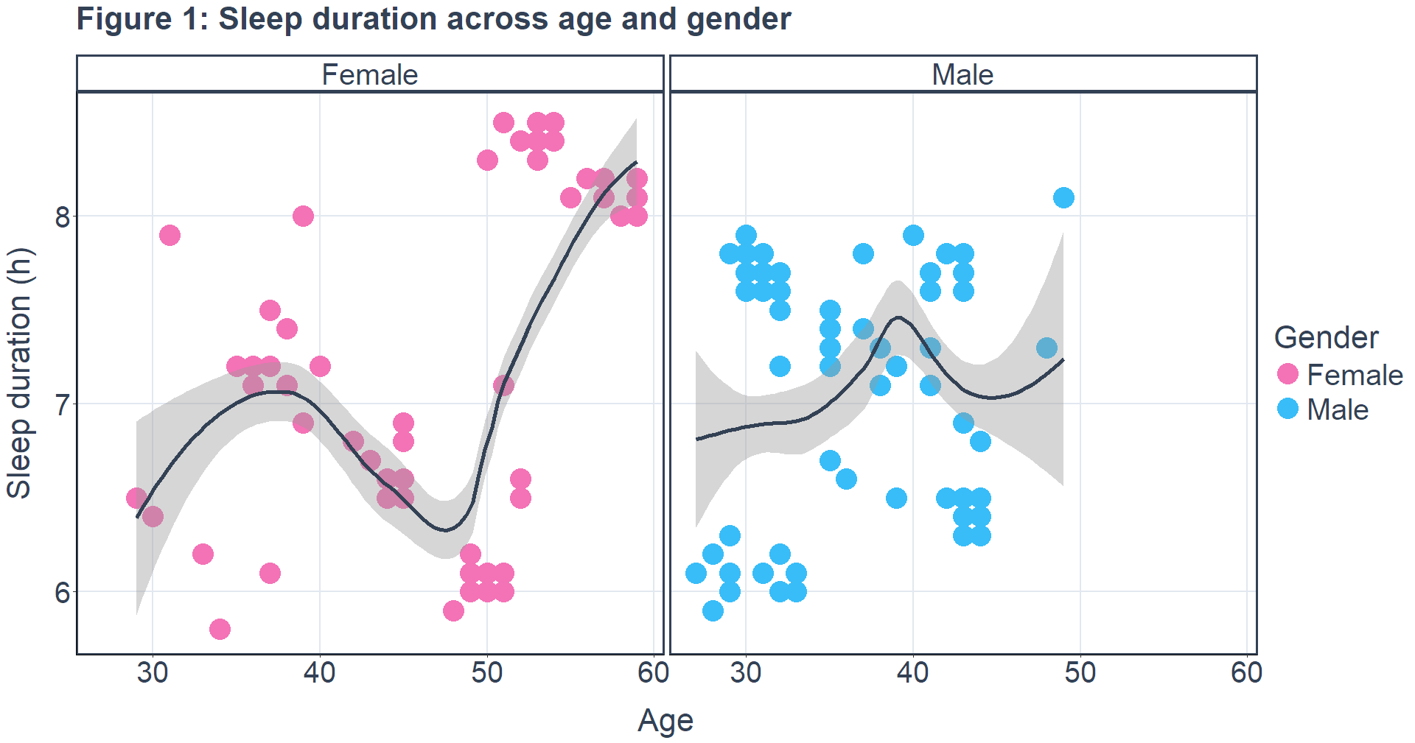

Results & Discussion
Notes:
Figure 1 shows ... Both men and women sleep less than 8 hours before the age of 50. Women tend to sleep more than 8 hours after the age of 50, but no data is available for men.

Slide 5
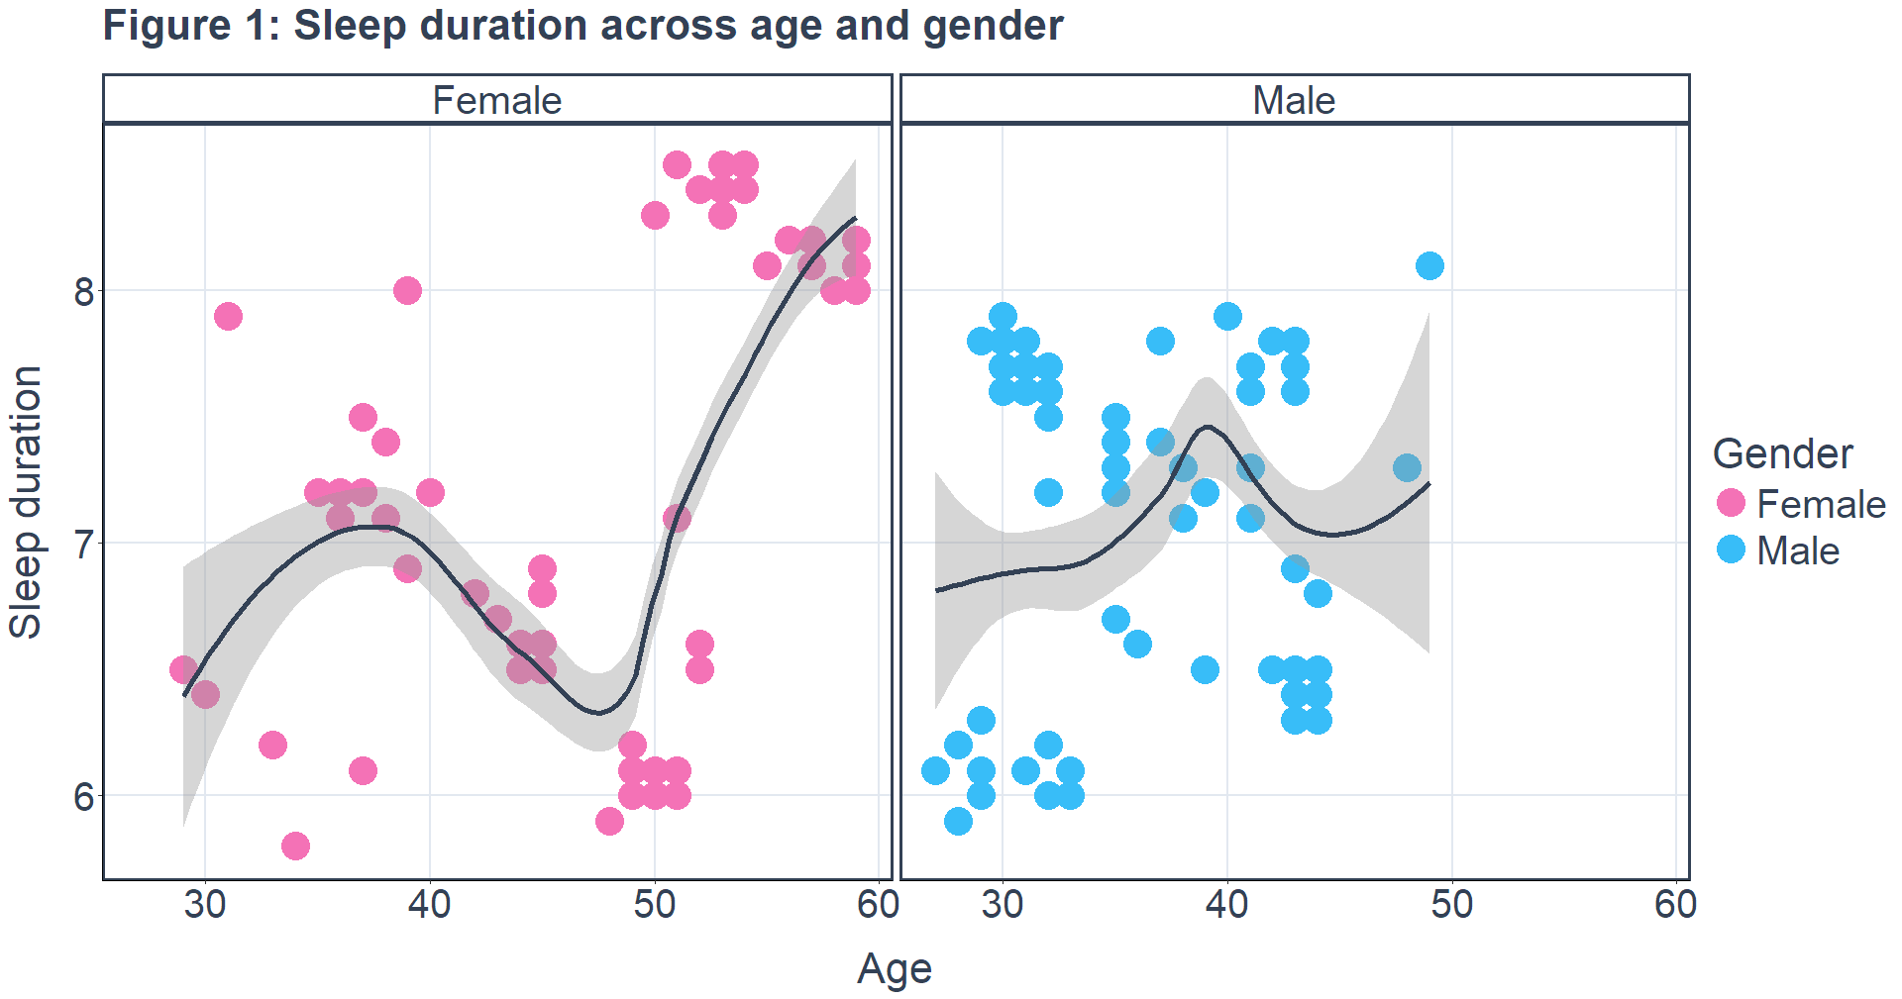
Results & Discussion
Previous studies in New Zealand show that adults over 65 are more likely to have longer sleep durations compared to younger adults.
Notes:
This helps me predict that men’s sleep duration may also increase with age, similar to women.

Slide 6
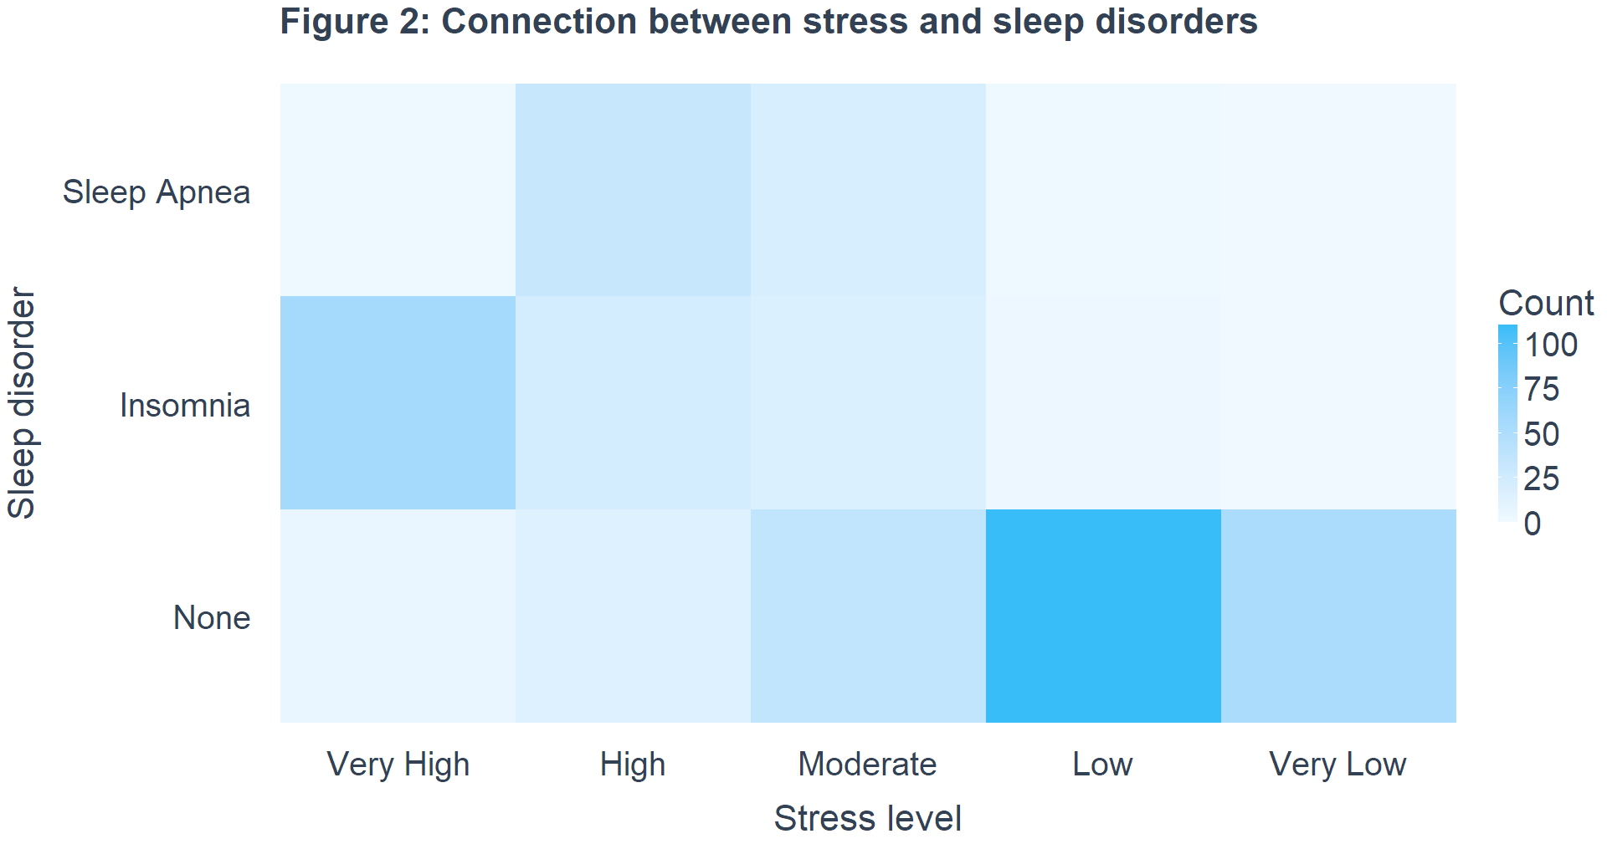
Results & Discussion
(Interrupted breathing)
(Can’t sleep)
Notes:
Previous studies indicates that high stress level is the strongest cause of insomnia, followed by sleep apnea.

Slide 7
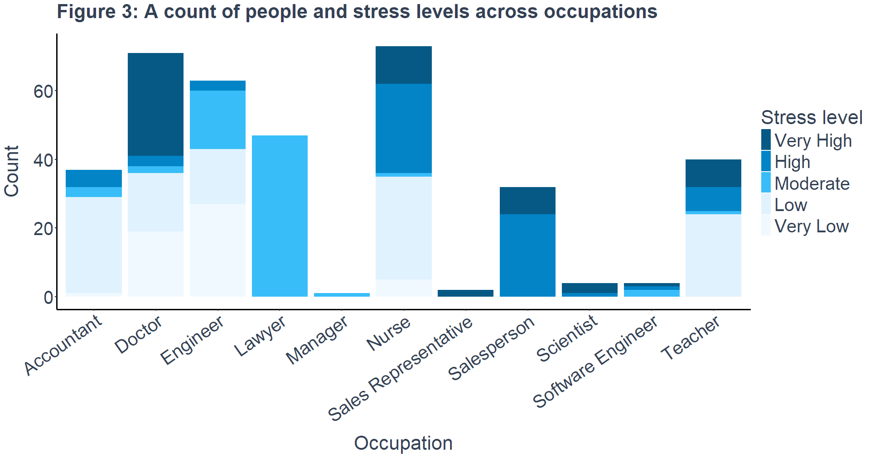
Results & Discussion
Notes:
Besides, certain jobs like doctors, nurses, salespeople, scientists, software engineers, and teachers are associated with sleep disorders due to very high stress levels

Slide 8
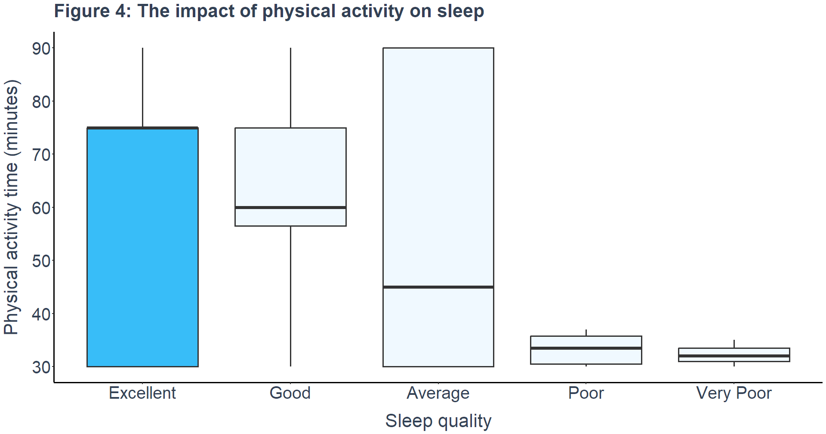

Results & Discussion
Notes:
From the data, we can see that if we do more exercise, at least 30 mins after a long day at work, we can improve our sleep quality a lot.

Slide 9
Conclusion & Future studies
Lifestyle factors have big impact on sleep health.
A good tip for better health and sleep is to exercise more, avoid staying up late to work or study.
Future studies:
Technology Use: Investigate how daily screen time on phones, computers, and social media apps affects sleep, especially due to blue light and mental stimulation.
Alcohol and Substances: Examine how alcohol and other substances impact sleep, focusing on timing and consumption levels.
Eating Habits: Analyze late-night eating and meal choices to determine their influence on sleep quality and duration.

Slide 10
References
Rosemary Gibson, Tasnima Akter, Courtney Jones, Andy Towers, "Characteristics of Atypical Sleep Durations Among Older Compared to Younger Adults: Evidence from the New Zealand Health Survey," The Journals of Gerontology: Series A, Volume 78, Issue 10, p. Pages 1908–1918, October 2023.
R. M. Merrill, "Mental Health Conditions According to Stress and Sleep Disorders," International Journal of Environmental Research and Public Health, vol. 19, no. 13, p. 7957, 2022.
Dana Schultchen, Julia Reichenberger, Theresa Mittl, Tabea R M Weh, Joshua M Smyth, Jens Blechert, Olga Pollatos, "Bidirectional relationship of stress and affect with physical activity and healthy eating," Br J Health Psychol, vol. 24, no. 2, pp. 315-333, 2019.

Slide 11


Thank you
Thinh Le
let9@go.stockton.edu
letatthinh.vercel.app

